Slide 1
Advanced Business
Communicating Design
With LoRa Communication Protocol

Slide 2

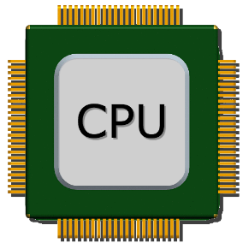

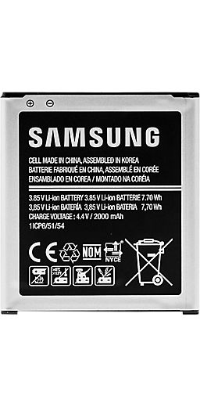
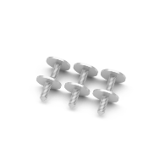
Existing Industrial IoT Networks
원양어선
도매
소매

Slide 3
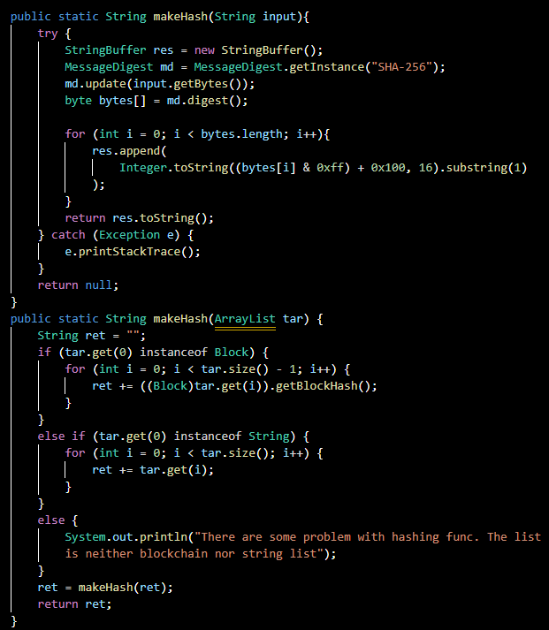
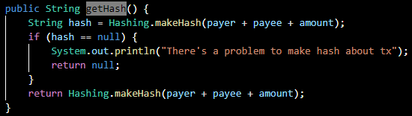
Existing Industrial IoT Networks
Using internet networks and Wi-Fi, coverage is local and expensive

Slide 4
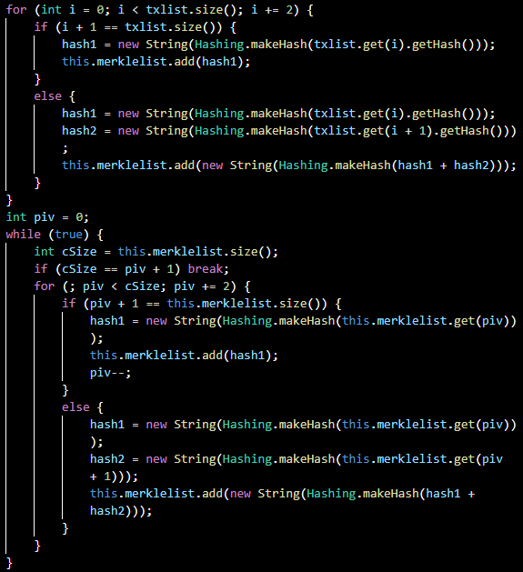
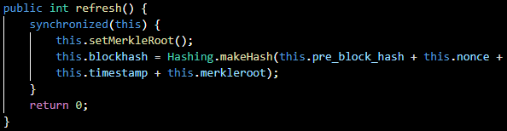
Existing Industrial IoT Networks
Using internet networks and Wi-Fi, coverage is local and expensive

Slide 5
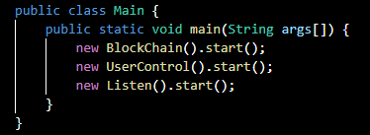
Existing Industrial IoT Networks
Using internet networks and Wi-Fi, coverage is local and expensive

Slide 6
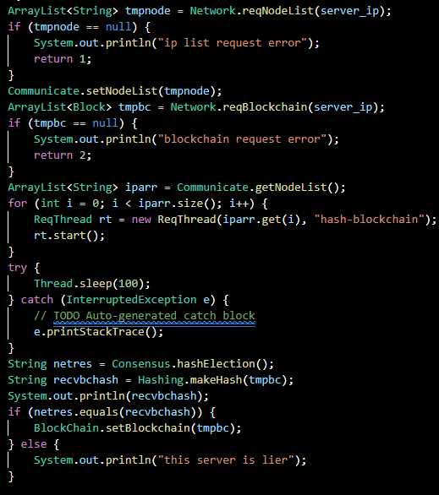
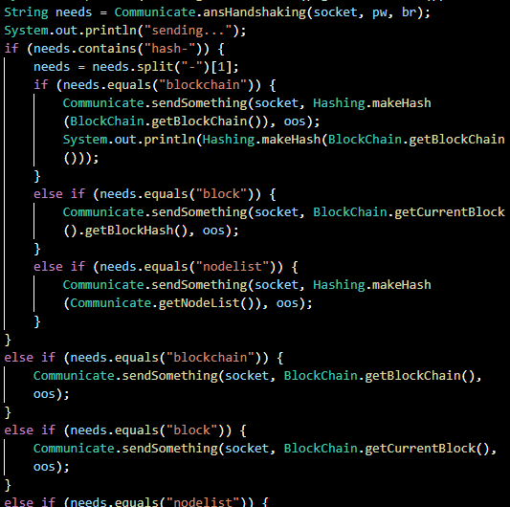
Existing Industrial IoT Networks
Using internet networks and Wi-Fi, coverage is local and expensive

Slide 7
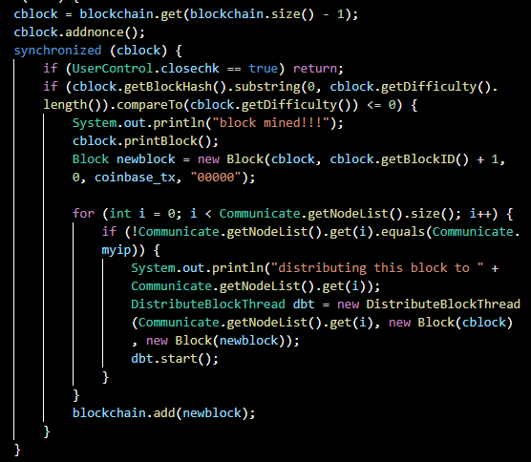
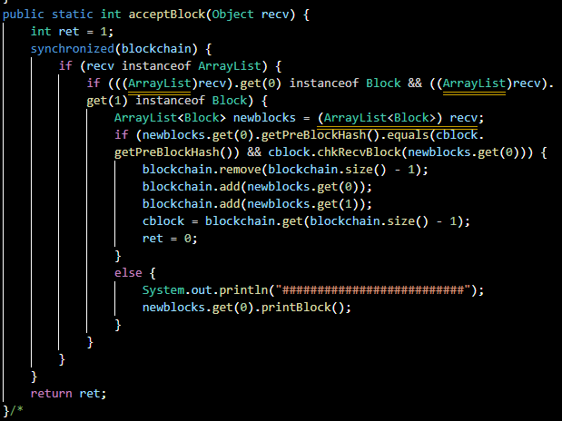
Existing Industrial IoT Networks
Using internet networks and Wi-Fi, coverage is local and expensive

Slide 8
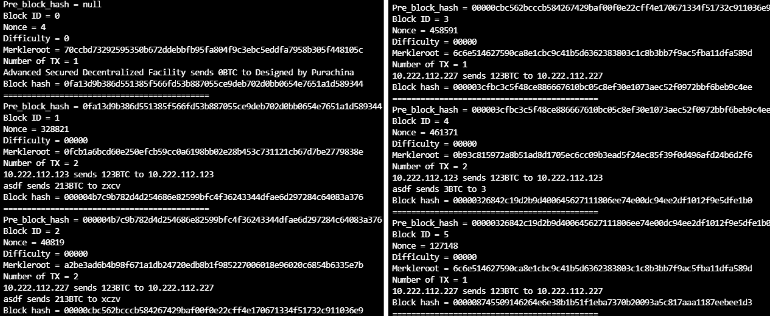
Industrial IoT model
With LoRa protocol
Although the speed is limited, it is free and has wide coverage

Slide 9
Industrial IoT model
With LoRa protocol
Although the speed is limited, it is free and has wide coverage

